Slide 1
Medicinal chemistry of Anesthetics

Slide 2
Neurobiology of Anesthesia
Anesthesia: loss of feeling or sensation
Drug- induced anesthesia:
  systemic administration of agents: general anesthesia
    promote loss of sensation and consciousness through CNS depression
    complete loss of consciousness that is not responsive to external stimuli
  regional administration of agents: local anesthesia
    promote loss of sensation by inhibiting local sensory neurotransmission in a given tissue

Slide 3
General anesthesia
sedative- hypnotics, analgesics, and neuromuscular b locking agents
  can induce or potentiate anesthesia
characterized by amnesia, analgesia, and temporary paralysis of muscles
  driven primarily by acetylcholine (ACh) neurons within the thalamus
  glutamatergic, GABAergic, and orexinergic neurons within the reticular formation, thalamus, and hypothalamus responsible for sedative/hypnotic effects are also involved

Slide 4
cerebral blood flow and brain glucose metabolism are drastically affected within the thalamus, higher levels of GABA receptors
  region of the brain is greatly influenced by GAs
thalamo-cortical axis is a major regulator of anesthetic- induced unconsciousness
inhibiting the high- frequency pulses of arousal sensing information through the thalamo-cortical and reticulo-thalamo- cortical ascending arousal structures

Slide 5
Four pharmacological targets
GABA A receptors activation
NMDA receptors(NMDA- R) antagonism
nicotinic-Ach receptors (nAChR) antagonism
two-pore domain K⁺ channels (e.g., K2P channels) hyperpolarizes neurons
voltage-gated Na+ channels

Slide 6
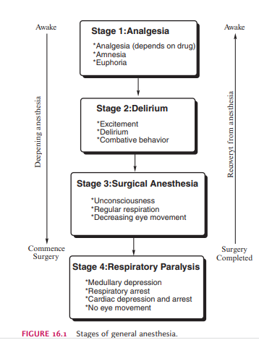
The ideal anesthetic combination will allow the patient to proceed quickly from stage I to stage III and avoid stage IV

Slide 7
Types of General Anaesthetics
Inhalation anaesthetics (volatile liquids or gases)
  Nitrous oxide
  Halothane, enflurane, isoflurone, desflurane, sevaflurane, and methoxyflurane are volatile liquids.
Intravenous anaesthetics:
  used intravenously, alone, or in combination with other drugs to achieve an anaesthetic state for minute surgery of the patients in the intensive care unit.

Slide 8
Inhalation anesthetics(volatile liquids or gases)
volatile fluorinated hydrocarbons: isoflurane, sevoflurane, desflurane, and enflurane
nonvolatile gas nitrous oxide(N₂O)
the concentration of anesthetic in the bronchiolar alveoli reaches equilibrium with that in the inspired gas mixture

Slide 9
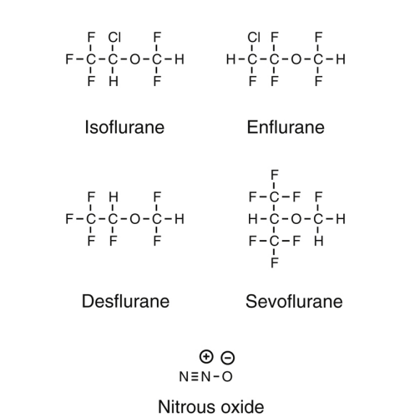
1-chloro- 2,2,2-trifluoroethyl difluromethly ether
2-chloro- 1,1,2-trifluoroethy l- difluoromethy l ether
1,2,2,2-tetrafluoroethy l- difluoromethyl ether
Fluorinated agents
all derived from diethyl ether
All have high degrees of lipophilicity
2,2,2-trifluoro- l- (trifluoromethyl) ethyl ether
‘laughing gas’
Structures of inhaled general anesthetics

Slide 10
Ideal:
inexpensive, potent,
pleasant to inhale
minimally soluble in the blood and tissues
stable on the shelf and during administration
lack undesirable side effects such as cardiotoxicity, hepatotoxicity, renal toxicity, and neurotoxicity.

Slide 11
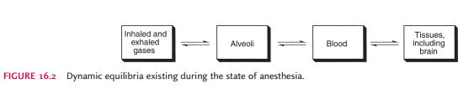

Slide 12
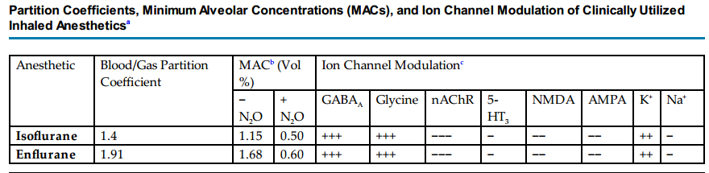


Slide 13
SOLUBILITY:
the ideal general anesthetic will have low solubility in blood conveyed by the blood: gas partition coefficient
  ratio of the concentration of the drug in the blood to the concentration of the drug in the gas phase (in the lung), at equilibrium
  For the drug to have a quick onset,
    the solubility in the blood should be low, thus saturation will occur quickly, and the drug can then move into the tissue compartment.

Slide 14
higher partition coefficients have higher lipophilicity and higher blood solubility
  More anesthetic will need to be dissolved to saturate the blood in order to reach the brain
  yielding a slower induction
low blood solubility and lower blood/gas partition coefficients
  Rapidly saturate the blood and then rapidly enter the brain for a quick inductive effect
  faster emergence and recovery from the anesthetic effect

Slide 15
induction of anesthesia can be modulated by factors including
  physiochemical characteristic
  concentration, ventilation, and
  cardiac output
    inversely correlated to induction
    Greater levels of cardiac output will remove more anesthetic from the gas phase via the greater blood flow to the lungs

Slide 16
Blood/gas partition coefficients rank order
Enflurane > isoflurane > sevoflurane > nitrous oxide ≥ desflurane
Rank order of potencies of MAC₅₀ in 100% oxygen
Isoflurane > enflurane > sevoflurane > desflurane >nitrous oxide
MAC :
  the concentration of vapor (as a percentage of 1 atmosphere in the alveoli) required to prevent motor responses in 50% of adult patients subjected to a Standardized surgical stimulus
  Assume that equilibrium between the gas/alveoli/blood/brain compartments has been reached

Slide 17
lower MAC value denotes a more potent anesthetic effect
  coadministration of nitrous ox ide with a volatile anesthetic is additive
  1% increase in nitrous ox ide allow s for a similar percentage reduction in the MAC of the volatile anesthetic

Slide 18
Chemical Considerations and SARs of Inhaled Anesthetics
Replacement of diethyl ether’s hydrogen groups with fluorine atoms
  preserves the steric features of the small hydrogen atom
  greatly enhancing lipophilicity of the fluorinated congeners
  lowers the boiling point , decreases flammability and toxicity ,and increases stability

Slide 19
Halothane:
  halogenated alkane structural backbone
  associated with cardiac arrhythmias
  ether backbone reduces the likelihood of this effect 4-fold
  clinically useful agents of today are based on the halogenated methyl ethyl ether backbone
no definitive SAR exist for these agents that allow for accurate predict ions of anesthetic activity

Slide 20
least one hydrogen is necessary for anesthetic effect
full halogenation of the agents
  loss of anesthetic effect and promotes convulsant effects
  electron withdrawing groups, coupled with heightened lipophilicity
  clinically useful fluorinated anesthetics contain a chiral carbon and hence exist as (+) and (−) enantiomers
  all of the commercially available formulations contain racemic mixtures

Slide 21
(+)-isoflurane
  twofold the efficacy of the (−) enantiomer in potentiating K+- efflux and inhibiting nAChR
  more potentiating effects at GABA A receptors
  stereoselective requirements of ion channels and receptors
structural isomer of enflurane

Slide 22
Enflurane
2-chloro-1,1,2-trifluoroethyl-difluoromethyl ether

Slide 23
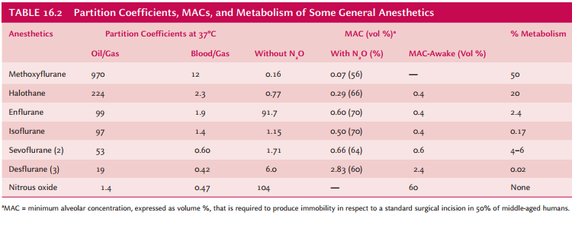
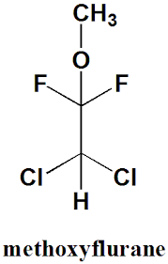
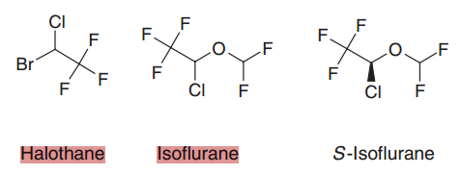
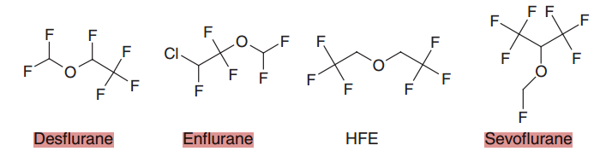

Slide 24
Halothane
first compound specifically synthesized to be an inhaled general anesthetic
nonflammable liquid, halogenated alkene with a blood/gas coefficient of 2.3 and an MAC in 100% oxygen of 0.74 and 0.29 in 70% nitrous oxide.
produce any depth of anaesthesia without causing hypoxia
Being a nonirritant, its inherent hypotensive effect retards capillary bleeding and renders a comparatively bloodless field.
produces a dose-dependent reduction (20–25%) in arterial blood pressure at its MAC and increases cerebral blood flow, raising intracranial pressure.
For skeletal muscle relaxation, it is used with succinylcholine or tubocurarine

Slide 25
Very potent, with high oil/gas, blood/gas partition coefficients
Long induction time and recovery
Toxic metabolite(fatal hepatotoxicity), malignant hyperthermia(uncontrolled Ca²⁺ efflux)(hypermetabolic, condition that is potentially lethal)(treated with dantrolene)
Photochemical instability: evolves bromine when exposed to light
negative inotropic actions
myocardial depression
sensitizes the myocardium to the arrhythmogenic effects of epinephrine

Slide 26
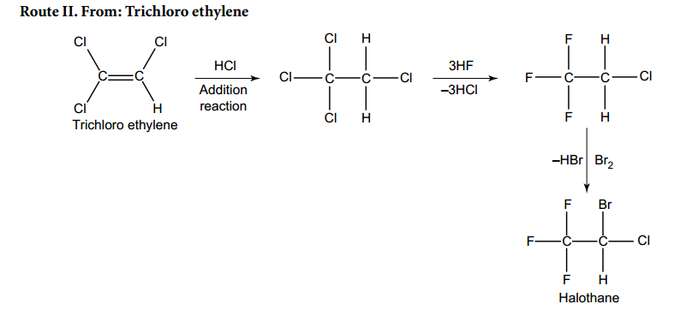

Slide 27
Metabolism
metabolized to three major metabolic products,
  trifluroacetic acid,
  N-trifluro acetyl ethanolamine, and
  N-acetyl-s-(2-bromo,2 chloro-1,1-difluro ethyl)-1-cysteine

Slide 28
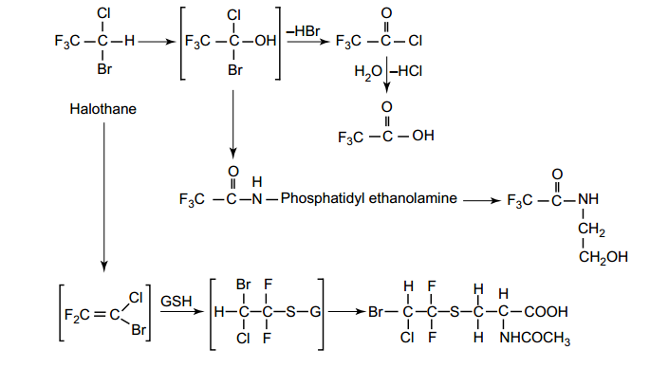

Slide 29
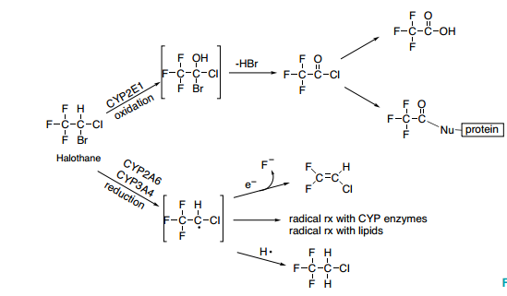

Slide 30
Isoflurane
1-chloro-2,2,2-trifluoroethyl difluromethly ether, structural isomer of
enflurane
blood/gas coefficient of 1.4
MAC in 100% oxygen of 1.15 and in 70% nitrous oxide of 0.50.
Induction of anesthesia is achieved with 3–4% isoflurane in air or in oxygen, or 1.5–3% in 65% nitrous oxide

Slide 31
use of isoflurane alone can lead to coughing and apneic periods
  used in combination with intravenous anesthetics
  faster recovery than with halothane or enflurane
Greater than 99% of inhaled isoflurane is expired unchanged from the lungs
less than 0.5% of the agent being biotransformed by the liver to yield trifluoroacetic acid and F-

Slide 32
dose-dependent reduction in arterial blood pressure due to peripheral vasodilatation
  no effect on cardiac output
increases cerebral blood flow, and may raise intracranial pressure
much less potent than with halothane
does not sensitize the myocardium to produce arrhythmias
trigger malignant hyperthermia

Slide 33
Enflurane
2-chloro-1,1,2-trifluoroethyl-difluoromethyl ether
blood/gas coefficient of 1.8, slower induction and emergence from
produces surgical analgesia in 7-10 minutes after a single dose
recovery occurs within 5 minutes following discontinuation
The MAC in 100% oxygen is 1.68 and that in 70% nitrous oxide is 0.57

Slide 34
Induction of anesthesia is achieved by using 3–4% enflurane in air or in oxygen or 1.5–3% in 65% nitrous oxide
used as a maintenance, rather than an induction, agent
enhances the action of paralyzing agents
80% and 90%: expired unchanged
10% oxidized metabolite by CYP2E1: excreted in the urine

Slide 35
Greater than 95% of the F- is excreted readily after termination of anesthesia, significantly decreasing the comparative clinical incidence of toxicity

Slide 36
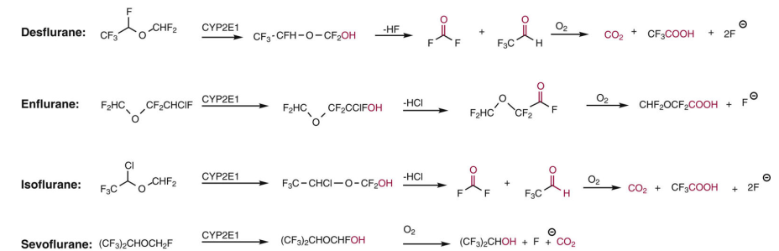
Metabolism of volatile inhaled general anesthetics

Slide 37
negative inotropic effects(reduction in arterial blood pressure)
does not sensitize the heart
increase intracranial pressure and, especially in combination with hyperventilation, increases the risk of seizure activity
trigger malignant hyperthermia

Slide 38
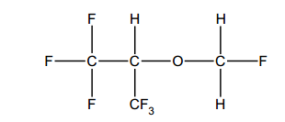
Sevoflurane fluoromethyl 2,2,2-trifluoro-l-(trifluoromethyl) ethyl ether
isopropyl ether
blood/gas coefficient of 0.59
rapid induction of anesthesia(1-2 minutes)
and rapid recovery following discontinuation from inhalation(4-10 minutes )
The MAC in 100% oxygen is 1.71 and that in 63% nitrous oxide is 0.66
widely used in outpatient surgical and pediatric care settings
40% of inhaled sevoflurane is excreted unchanged in expired air

Slide 39
oxidative defluorination of 3%-5% of the inspired agent(CYP2E1)
The remainder is likely metabolized by unknown extrahepatic mechanisms yielding hexafluoroisopropanol and F-
Increasingly replacing halothane
Less potent than halothane
Lower oil/gas and lower blood/gas partition coefficient

Slide 40
Sevoflurane causes less airway irritation, resulting in less coughing and excitation during induction.
It can be used without intravenous anesthetics.

Slide 41
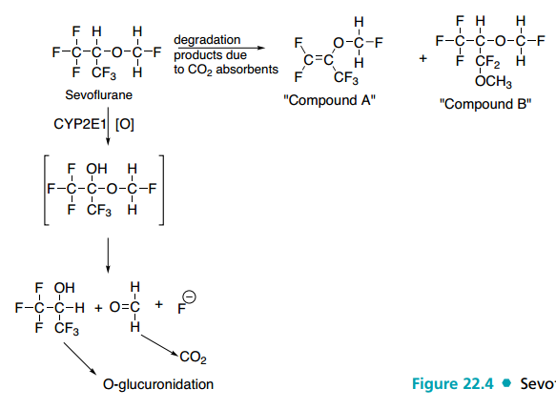
nephrotoxic
pentafluoroisopropenyl fluoromethyl ether
Sevoflurane metabolism and chemical instability
nephrotoxic fluoride ion

Slide 42
Nitrous Oxide
has very a low blood/gas partition coefficient (0.47) (rapid induction)
incapable of producing surgical anesthesia when used alone (MAC of 105%)
blockade of nAChR and NMDA channels, activation of two-pore K+ channels
rapidly and nearly fully eliminated unchanged from expired air
cardiac arrhythmia
irreversible oxidation of the cobalt atom of vitamin B₁₂

Slide 43
converts the monovalent cobalt form of vitamin B12
(Co+) to the divalent form
incapable of acting as a cofactor for the enzyme
methionine synthetase(nucleic acid synthesis, synthesis of myelin)
erythropoiesis, anemia, and myelosuppression

Slide 44
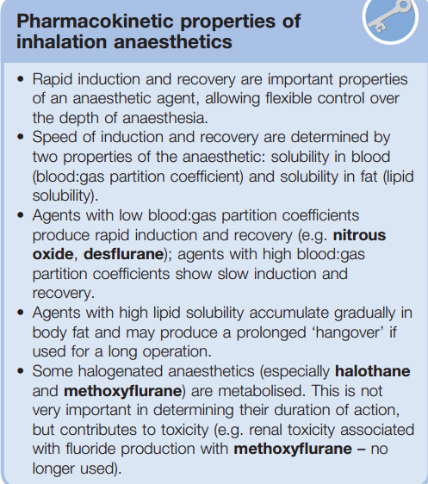
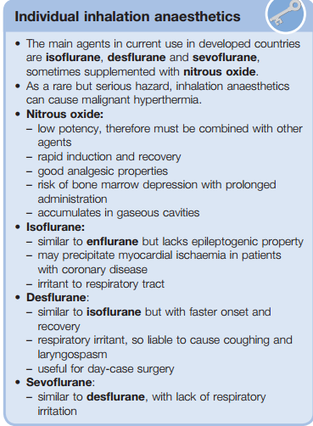

Slide 45
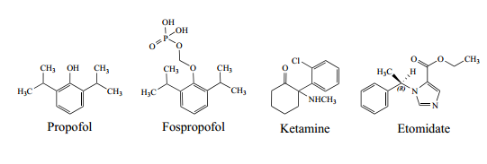
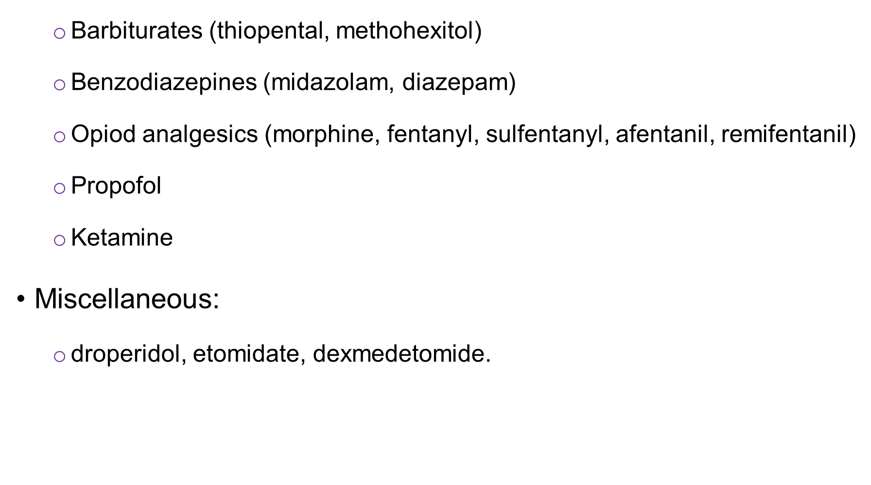
The Injectable (Nonvolatile General Anesthetics)
thiopental and thiamylal
High lipophilicity
faster rate of anesthetic act ion than the inhaled GAs
induction of anaesthesia
utilized greatly in the induct ion of anesthesia

Slide 46
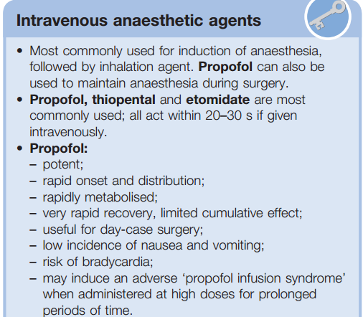
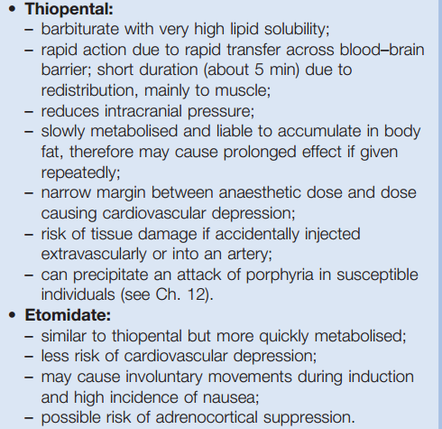

Slide 47
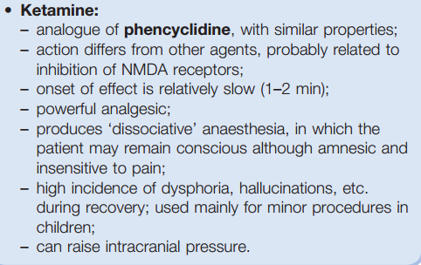

Slide 48
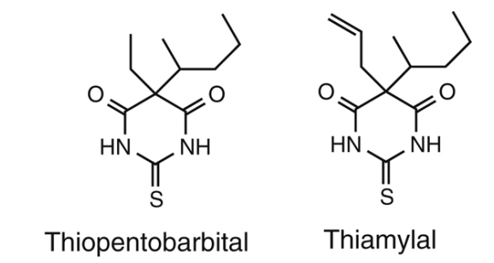
Ultra short-acting barbiturates

Slide 49
rapid penetration to the brain that typically occurs within
10-20 seconds
rapidly lost within 5-7 minutes of a bolus dose
continuous infusion or multiple administrations can lead to long-lasting unconsciousness
  first-order to zero-order kinetics with slow biotransformation and elimination
  problematic in patients with hepatic or renal dysfunction or in pregnant mothers induced for caesarian section

Slide 50
hypotension, decreases in cardiac inotropy, and respiratory depression
they are formulated in alkaline solutions.
Mixing these agents with other drugs in more acidic solutions inhibits tautomerization and shifts the equilibrium, stabilizing the inactive barbituric acid form
when used for anesthesia, barbiturates are administered first and should clear the tubing prior to administration of other IV agents

Slide 51
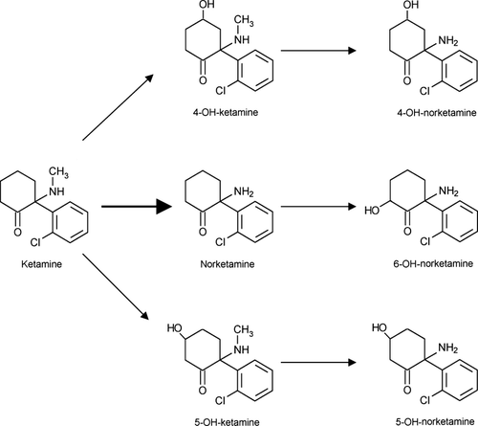
Ketamine(Aryl cyclohexylamine)
metabolized in humans primarily via N-demethylation by CYP3A4 with minor contributions by CYP2B6 and CYP2C9
Ketamine is metabolized mainly to norketamine (80%)

Slide 52
prevents the flow of cations, such as calcium, sodium and potassium along their concentration gradients and prevents depolarization of the neuron
dissociative anesthetic(produces unpleasant hallucinations and strong feelings of dissociation from the environment
produces psychological side effects ranging from transient pleasant “dream-like” states to vivid hallucinations and delirium

Slide 53
It also increases blood pressure, cerebral blood flow, and intracranial pressure(coadministration of BZs or thiopental)
acts as a modulator of the NMDA receptor and can also block monoamine uptake, leading to indirect sympathomimetic activity

Slide 54
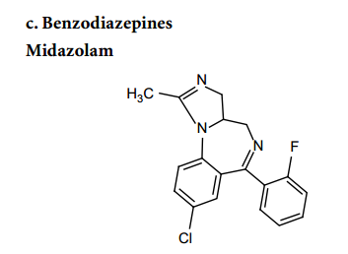
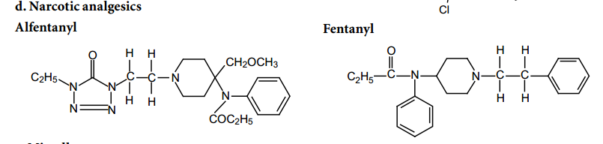

Slide 55
Propofol:2,6-diisopropylphenol
highly lipophilic with a log P of 4.15
formulated in an oil-in-water emulsion
  Disodium edetate (0.005%) is added
quickly passes through the BBB and produces a loss of consciousness within 40’’

Slide 56
  potentiates the effects of GABA,decreases its dissociation rate from receptor,
  enhances effect of Barbs, BzDs,
  inhibits presynaptic GABA uptake, influence GABA release ,
  modulation of glycine, nACh, and NMDA receptors
much shorter-acting than thiopental (clearance is greater than liver blood flow)

Slide 57
Structure-Activity Relationships of Propofol
2,6-dialkylphenols
  anesthetic potencies and kinetics are strongly correlated to the lipophilicity and steric bulk/localization of the substitutions
mono-o-substituted alkyl phenols: moderate hypnotic/anesthetic effects with poor therapeutic ratios
mono-p-substituted phenols: high degrees of respiratory depression
  di-, tri-, or tetrasubstitutions that included a m-position alkyl displayed poor anesthetic properties

Slide 58
propofol-like 2,6-disubstituted alkyl derivatives with linear ethyl, n-propyl, or n-butyl groups displayed moderate anesthetic properties with slow induction and increased durations as the chain lengths increased
2-n-alkyl, 6-sec-alkyl substitutions: increased anesthetic potency until the total number of carbons in the substituents reached 8, while cyclohexyl substitution decreased potency

Slide 59
2,6-di-sec substituted alkyl: highest anesthetic potencies
  Total number of carbons not exceed 6 and the substitutions acyclic
  induction slow and recovery prolonged when the total number of carbons in
  the substituents > 8

Slide 60
Pharmacokinetics and Metabolism of Propofol
it is a highly lipophilic agent that produces rapid CNS effects with a fast blood-brain equilibrium half-life of 3 minutes and
rapid redistribution from the CNS after a single bolus dose
recovery periods of 3-8 minutes depending on the dose
very high rate of clearance of 25- 50 mL/kg/min, a roughly 10-fold faster rate than thiopental
much faster recovery when administered in multiple doses or upon infusion

Slide 61
metabolized rapidly via hepatic CYP2B6-mediated biotransformation

Slide 62
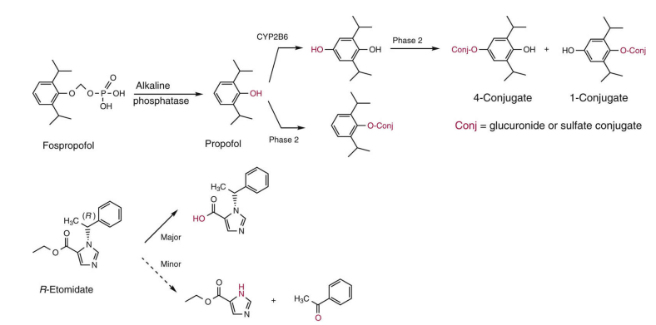
Metabolism of propofol and etomidate

Slide 63
extensively metabolized via glucuronidation of the phenolic hydroxyl as well as Phase I oxidation of the para position followed by Phase II metabolism
Rapid awakening of the patient occurs 10 to 15 minutes after the infusion is stopped
The most notable adverse reactions of propofol are respiratory depression, bradycardia hypotension and elevated triglycerides
acts at least in part by blocking Nav channels

Slide 64
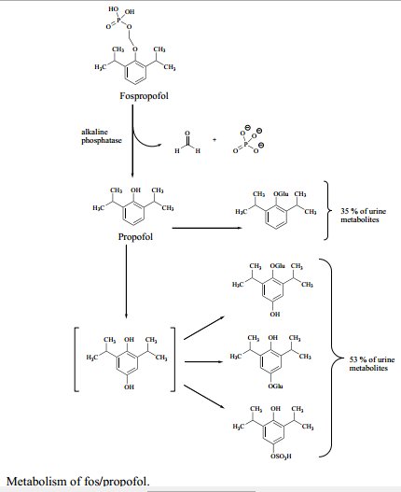
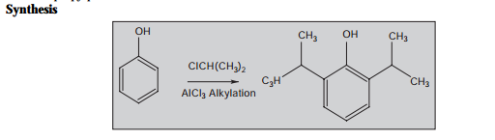
Fospropofol:
water soluble pro-drug
quickly metabolizedvia endothelial alkaline phosphatase enzymes to yield propofol
avoids the hyperlipidemic concerns of propofol administration.
Onset of action: (8 minutes for fospropfol versus40 seconds for propofol).

Slide 65
Etomidate
a chiral compound marketed as the more potent R (+) enantiomer.
a substituted imidazole that is used in the form of its active D-isomer
Poorly water-soluble
distribution across the BBB and quick onset of action
Metabolism includes ester hydrolysis with 75% of the drug eliminated in the urine as the inactive carboxylic acid
lesser effect on cardiac output or blood pressure
suppress the adrenal axis even after a single dose

Slide 66
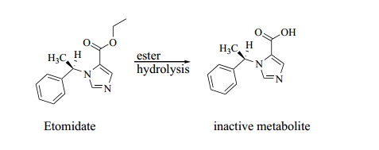
Etomidate may bind to amino acid residues on both the α and β subunits of GABA_{A} receptor

